Slide 1
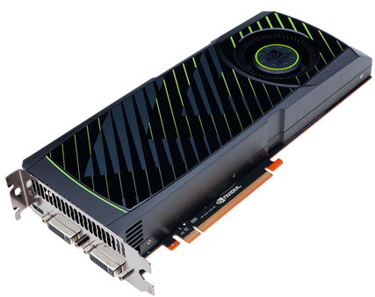
Bruteforcing DES
with CUDA on a GPU

Slide 2
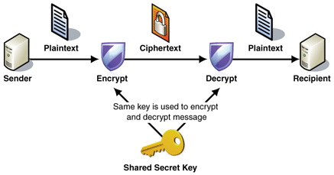
What is DES?
DES = Data Encryption Standard
Symmetric Encryption Algorithm by IBM (1975)
1b cd b8 89 88 e2 02 7f
plain123
plain123
keykeyke

Slide 3
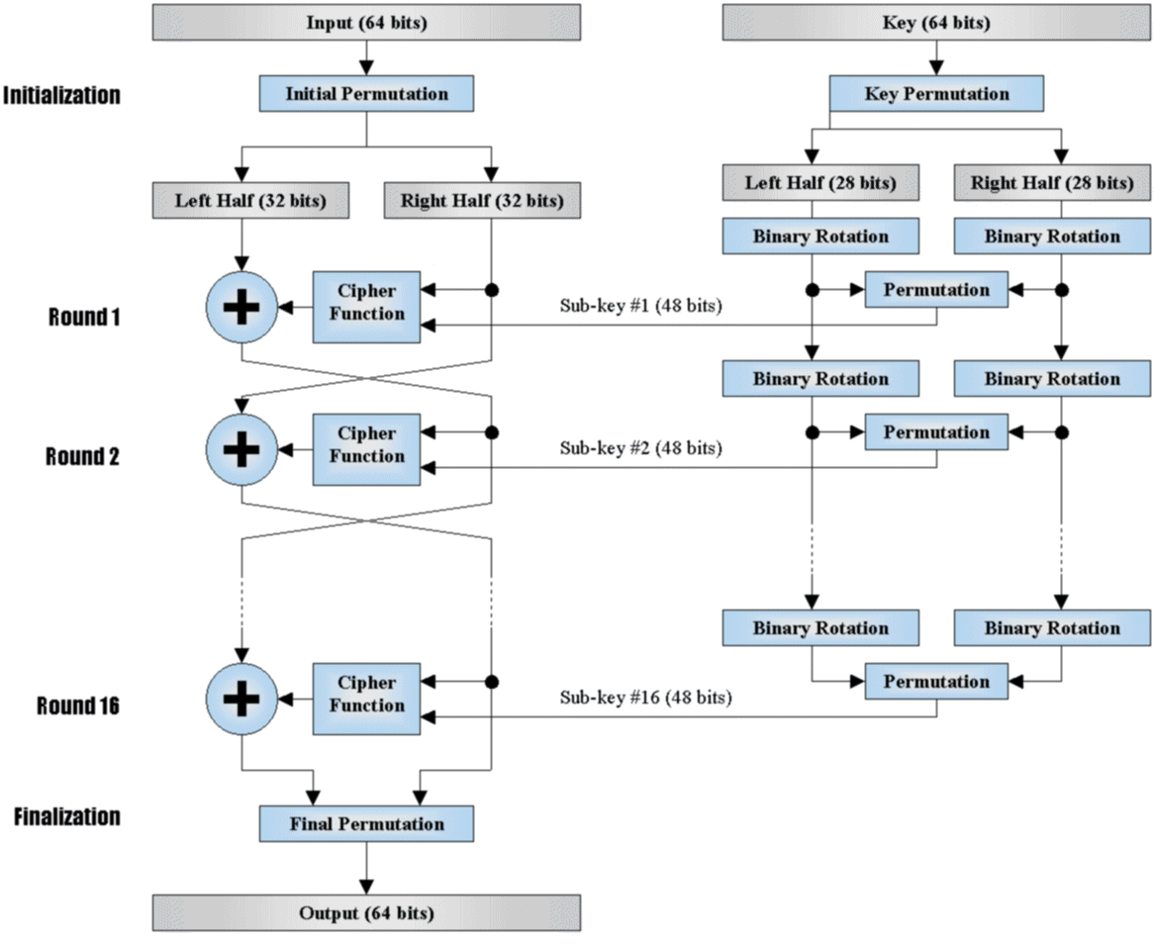
How does it work?

Slide 4
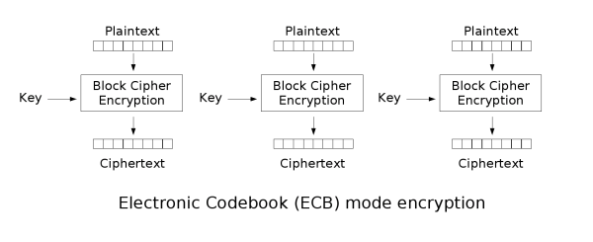


Modes of operation
ECB (Electronic Code Book)
Blocks can be encrypted in parallel
Weak encryption results

Slide 5
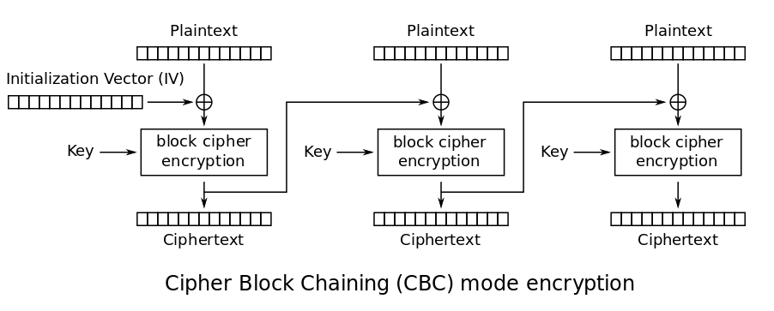

Modes of operation
CBC (Cipher Block Chaining)
Better encryption results
Not parallelizable

Slide 6
How to bruteforce
CUDA kernels try keys k_{i}
Until cipher == enc_{k}(plain)
tid
0
tid
1
tid
2
tid
30
tid
31
tid
32
tid
63
Key0
aaaa
Key1
baaa
Key2
caaa
Key30
ebaa
Key31
fbaa
Key32
aaaa
Key63
fbaa
…
…
Key64
gbaa
Key65
hbaa
Key66
ibaa
Key94
kcaa
Key95
lcaa
Key96
mcaa
Key127
ncaa
blockIdx 0
blockIdx 1
Each thread tries a different key
and jumps by blockDim.x * gridDim.x

Slide 7
Performance

Slide 8
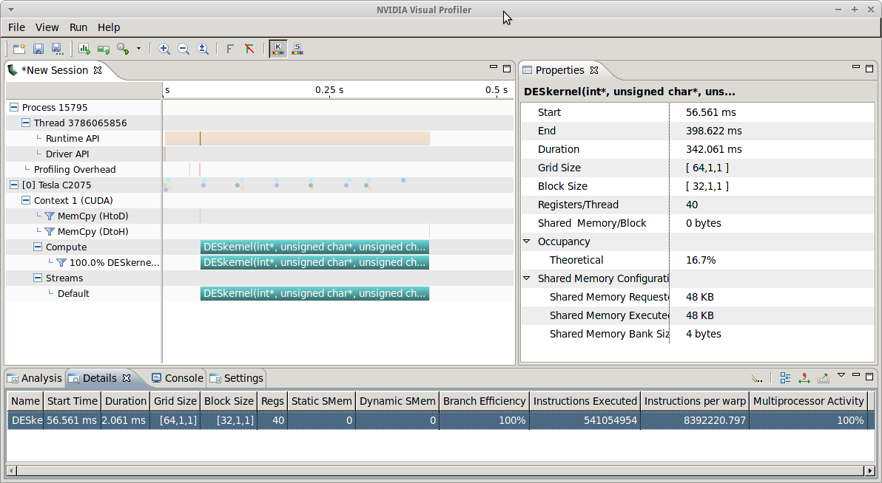
Profile

Slide 9
Outlook
Optimize parallel code
Analyze best combination of threads per block and blocks per grid. (I used 64,32)
Utilize multiple cards
Use found weakness of DES
Keys with distance 1 per byte yield same cipher.
Key keykeyke == jdxjdxjd == jdxkeyje

Slide 10
Thank you for your attention!
Questions?

